Slide 1
Backup Restore Scheduling Task

Slide 2
Backup Restore using tar command
tar features:
1. tar ( tape archive ) is used for single or multiple files backup and restore on/from a tape or file. 2. tar can not backup special character & block device files , shows as 0 byte files with first letter of permissions as b or c for block or character. 3. tar Works only on mounted file system, it can not access the files on unmounted file system.

Slide 3
Backing up all files in a directory including subdirectories to a tape device (/dev/rmt/0) or a file.
Example 1 :
$tar cvf /dev/rmt/0 *
In the command above Options are c -> create ; v -> Verbose ; f->file or archive device ; * -> all files and directories . Together the commands means create a tar file on /dev/rmt/0 from all file and directories s in the current directory.
Example 2:
$tar cvf /home/backup *

Slide 4
Viewing a tar backup on a tape or file
t option is used to see the table of content in a tar file.
$tar tvf /dev/rmt/0 ## view files backed up on a tape device.
$tar tvf /home/backup ## view files backed up inside the backup
In the command above Options are c -> create ; v -> Verbose ; f->file or archive device ; * -> all files and directories . Together the commands means create a tar file on /dev/rmt/0 from all file and directories s in the current directory.

Slide 5
Extracting tar backup from the tape
x option is used to extract the files from tar file.
$tar xvf /dev/rmt/0 ##extract / restore files in to current directory.
$tar xvf /home/backup ## extract / restore files in to current directory.

Slide 6
Compressing file/s
compress -v file_name gzip filename
To uncompress a file
uncompress file_name.Z or gunzip filename

Slide 7
Backup restore using cpio command
cpio features
1. Used for single or multiple files backup . 2. Can backup special character & block device files . 3. Works only on mounted file system. 4. Need a list of files to be backed up . 5. Preserve hard links and time stamps of the files .

Slide 8
Using cpio command to backup all the files in current directory to tape.
find . -depth -print | cpio -ovcB > /dev/rmt/0
cpio expects a list of files and find command provides the list, cpio has to put these file on some destination and a > sign redirect these files to tape. This can be a file as well .
Viewing cpio files on a tape
cpio -ivtB < /dev/rmt/0 ## Options i -> input ; v->verbose; t-table of content; B-> set I/O block size to 5120 bytes
Restoring a cpio backup
cpio -ivcB < /dev/rmt/0 ## Options i -> input ; v->verbose; t-table of content; B-> set I/O block size to 5120 bytes

Slide 9
Install dump package
Dump package contains dump and restore utilities and it also installs tape device package rmt.
[root@localhost ~]# yum install dump … Installed: dump.x86_64 1:0.4-0.24.b44.fc20
Dependency Installed: rmt.x86_64 2:1.5.2-9.fc20 Complete! [root@localhost ~]#

Slide 10
Full file system backup
After installation , dump can be used to take a file system backup In this example we will take full backup /dev/sda9 backup
Numerical argument as 0 is full backup and susquent number represant the incrementatl backup corresponding to full back.
Syntax is : dump – < level number > -f < source filesystem device >
-u Update the file /etc/dumpdates

Slide 11
[root@localhost ~]# /sbin/dump -0u -f /dev/st0 /dev/sda9 DUMP: Date of this level 0 dump: Wed Feb 8 22:10:13 2017 DUMP: Dumping /dev/sda9 (/boot) to /dev/st0 … DUMP: Writing 10 Kilobyte records DUMP: mapping (Pass I) [regular files] … DUMP: Volume 1 started with block 1 at: Wed Feb 8 22:10:13 2017 DUMP: dumping (Pass III) [directories] … DUMP: 122150 blocks (119.29MB) on 1 volume(s) … DUMP: Average transfer rate: 61075 kB/s DUMP: DUMP IS DONE [root@localhost ~]#

Slide 12
Incremental backup
Numerical argument as 2 is Incremental backup and subsequent number represent the incremental backup corresponding to full back.
-u updates the /etc/dumpdates files
[root@localhost ~]# /sbin/dump -2u -f /dev/st0 /dev/sda9 DUMP: Date of this level 2 dump: Wed Feb 8 22:14:13 2017 DUMP: Date of last level 1 dump: Wed Feb 8 22:13:06 2017 DUMP: Dumping /dev/sda9 (/boot) to /dev/st0 … DUMP: Date of this level 2 dump: Wed Feb 8 22:14:13 2017 … DUMP: DUMP IS DONE

Slide 13
Backup history
[root@localhost ~]# cat /etc/dumpdates /dev/sda9 0 Wed Feb 8 22:10:13 2017 -0800 /dev/sda9 1 Wed Feb 8 22:13:06 2017 -0800 /dev/sda9 2 Wed Feb 8 22:14:13 2017 -0800 /dev/sda9 3 Wed Feb 8 22:15:27 2017 -0800 /dev/sda9 4 Wed Feb 8 22:15:43 2017 -0800 /dev/sda9 5 Wed Feb 8 22:15:34 2017 -0800

Slide 14
Important Files related to backup
/dev/st0 default tape unit to dump to /etc/dumpdates dump date records /etc/fstab dump table: file systems /etc/mtab dump table: mounted file systems /etc/group to find group operator

Slide 15
Exit Status
Dump exits with zero status on success. Startup errors are indicated with an exit code of 1; abnormal termination is indicated with an exit code of 3.

Slide 16


Slide 17


Slide 18


Slide 19


Slide 20


Slide 21


Slide 22


Slide 23
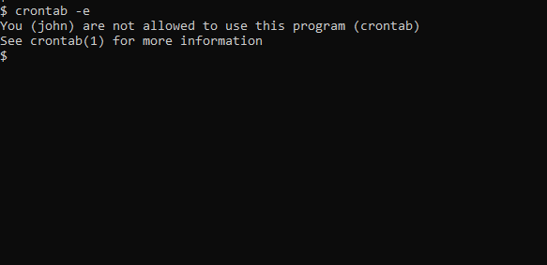
How to Control Access to crons
In order to use cron jobs, an admin needs to allow cron jobs to be added for users in the '/etc/cron.allow' file.
If you get a prompt like this, it means you don't have permission to use cron.

Slide 24
To allow John to use crons, include his name in '/etc/cron.allow'. This will allow John to create and edit cron jobs.

Slide 25
Scheduling tasks on Linux with cron
Cron is a daemon used to execute scheduled commands automatically. Learning how to use cron required some reading and experimenting, but soon I was using cron to shut down our email server, back up the data in a compressed tar file, then restart the email service at 3AM.
The commands for a cron job are stored in the crontab file on a Linux system, which is usually found in /etc/crontab. Display the contents of your crontab file with $ crontab -l.
Edit the crontab file with $ crontab -e.
$ EDITOR=vi crontab -e

Slide 26
A sample cron job
Suppose you want to scan your home directory for viruses and malware with clamscan every week on Monday at 10AM. You also want to back up your home directory every week on Tuesday at 9AM. Using cron and crontab files ensures that your system maintenance occurs every week whether you remember to run those utilities or not.
Edit your crontab file to include the following, using your own username instead of "don" (my user name):

Slide 27
# Scan my home directory for viruses 0 10 * * 1 clamscan -ir /home/don # Backup my home directory 0 9 * * 2 tar -zcf /var/backups/home.tgz /home/don

Slide 28
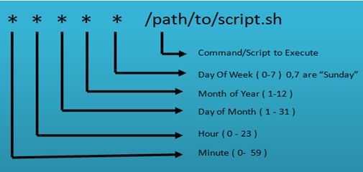

Slide 29
Using at
The at command is easy to use ,and there are only a few things to remember. A simple use of at might look like this:
$ at 5:00PM
at> date >> thisfile
at> <EOT>

Slide 30
Checking the queue
You can look at the queue of at jobs with the atq (at queue) command:
$ atq 32
Thu Apr 2 03:06:00 2020 a shs 35 Mon Apr 6 12:00:00 2020 a shs 36 Tue Dec 27 12:00:00 2022 a shs 34 Thu Apr 2 18:00:00 2020 a shs If you need to cancel one of the jobs in the queue, use the atrm (at remove) command along with the job number.

Slide 31
$ atrm 32 $ atq 35 Mon Apr 6 12:00:00 2020 a shs 36 Tue Dec 27 12:00:00 2022 a shs 34 Thu Apr 2 18:00:00 2020 a shs

Slide 32
Running jobs as root
To run at jobs as root, simply use sudo with your at command like this:
$ sudo at 8PM
[sudo] password for shs:
warning: commands will be executed using /bin/sh
at> reboot now
at> <EOT>
job 37 at Wed Apr 1 16:00:00 2020
Notice that the root task shows up in the queue with root 2020 a sh as the one to execute it.
35 Mon Apr 6 12:00:00 s
36 Tue Dec 27 12:00:00 2022 a shs
37 Wed Apr 1 20:00:00 2020 a root <==

Slide 33
Running scripts
You can also use the at command to run scripts. Here's an example:
$ at 4:30PM
warning: commands will be executed using /bin/sh
at> bin/tryme
at> <EOT>

